Slide 1
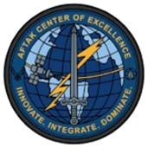
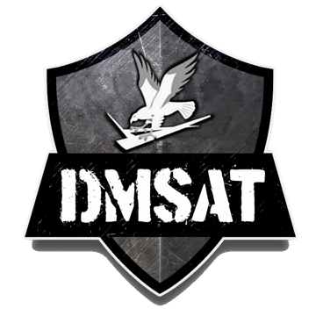

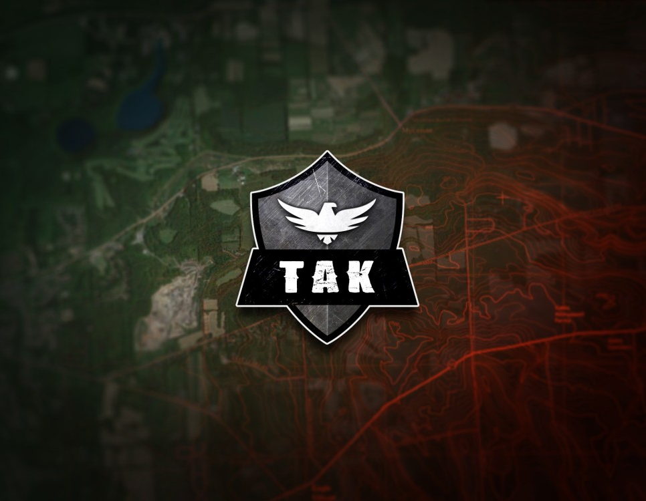


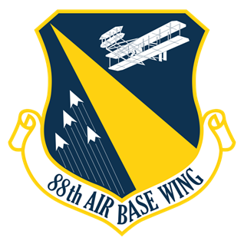
UNCLASSIFIED
AFTAK Center of Excellence
Mr. Kevan Dilworth
Program Manager
C2 Modernization Branch
COMM: 937-713-3938
Kevan.dilworth.3@us.af.mil
“Innovate. Integrate. Dominate.”

Slide 2
AFTAK Center of Excellence
MISSION:
To empower the warfighter by pioneering cutting-edge innovations for the Team Awareness Kit (TAK), delivering advanced capabilities that enhance efficiency, effectiveness, and safety for the United States Air Force and Space Force in dynamic operational environments.
VISION:
To be the forefront of tactical innovation, transforming the Team Awareness Kit (TAK) into a seamless, mission-critical tool that ensures unparalleled situational awareness, operational superiority, and safety for Air Force and Space Force personnel.
Critical Capabilities (CC):
CC-A: Enhanced Warfighter Communications
Deploy cutting-edge technologies to enable robust, tactical-level command and control (C2) through the Team Awareness Kit (TAK), ensuring seamless, secure, and real-time communication capabilities for warfighters in dynamic operational environments.
CC-B: Technology Interoperability and Scalability
Ensure TAK C2 systems adhere to interoperable, scalable, and sustainable technical architectures, facilitating seamless integration with existing and future systems while maintaining reliability and adaptability across Air Force and Space Force missions.
CC-C: Accelerated Digital Transformation
Transform legacy C2 technologies and processes by adopting innovative, modern methodologies within TAK, driving efficiency, agility, and mission effectiveness through advanced digital solutions tailored for the Air Force and Space Force.

Slide 3
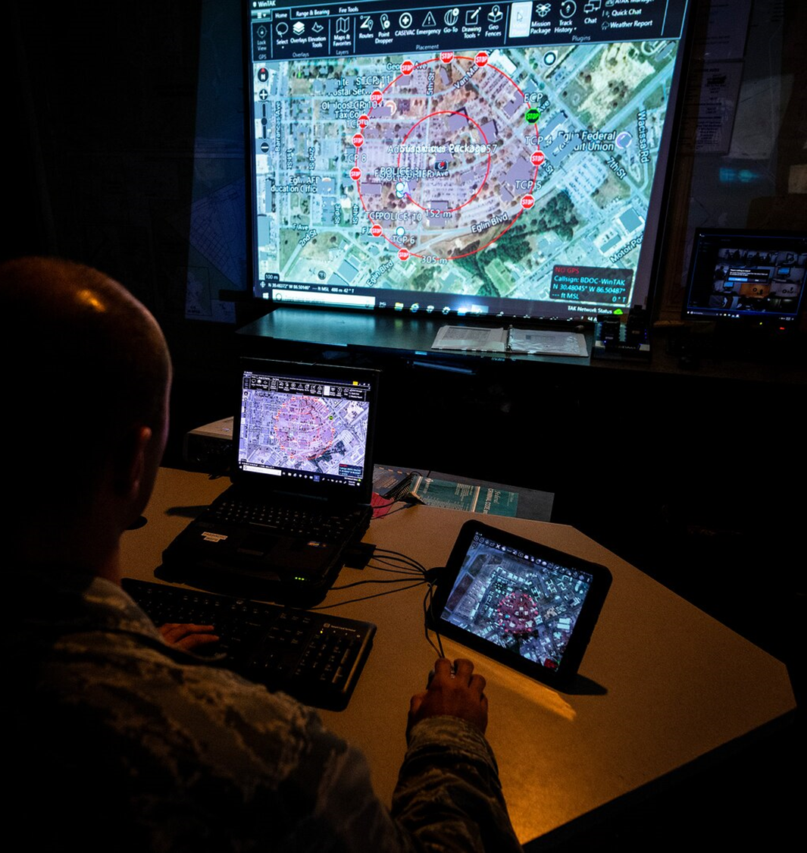
AFTAK Center of Excellence
What does it mean to be a CoE?
Framework & Concept Development
Research and write guidelines for how military forces approach standardized thinking and operating
Training & Education
Run courses and programs to train personnel, ensuring consistent levels of expertise across the force
Lessons Learned
Collect and analyze real-world operational experiences to identify what worked, what didn’t, and how to improve
Research & Experimentation
Work with researchers, contractors, and allied partners to test new concepts, technologies, and tactics before broader adoption
Interoperability & Cooperation
Serve as collaborative partners that align approaches, share knowledge, and develop common standards to work together more effectively
Advisory Role
Advise leaders and policymakers on emerging threats, capability gaps, and strategic direction within our area of focus
We think, learn, and teach so the fighting force is better prepared!
WHO WE ARE

Slide 4
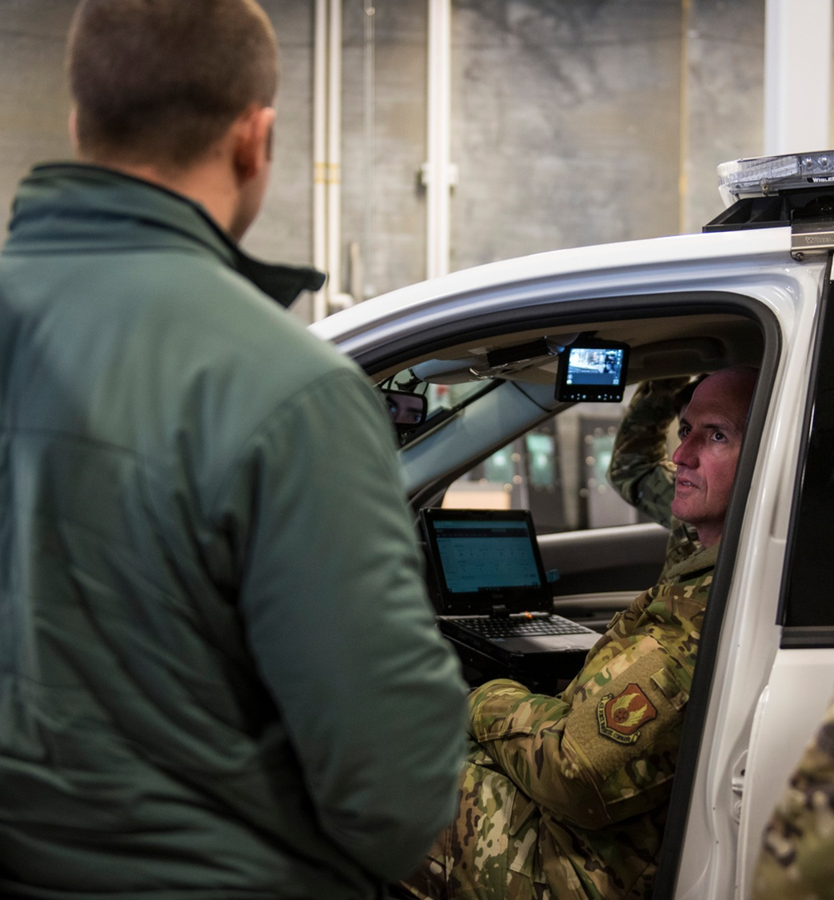
AFTAK Center of Excellence
Serving as the authoritative knowledge base for the TAK Ecosystem in USAF
We exist to make the TAK ecosystem accessible and useful regardless of AFSC or program, preventing siloed adoption and incompatible workflows
Standardizing integration without standardizing TTP’s
TAK is highly configurable and different missions require different configurations. We focus on establishing common technical standards, server architecture, and data exchange formats, while leaving tactical employment decisions to the units
Bridging the gap between programs
Since no single program office owns TAK across the enterprise, the CoE fills the coordination void by working across programs to ensure interoperability, reduce redundant workflow, and advocate for capability needs that don’t neatly fit one program’s scope
Training & enablement at the unit level
TAK proficiency is not formally embedded in most training pipelines, so we provide the training infrastructure that doesn’t exist elsewhere, helping units get operators and administrators up to speed
Supporting rapid fielding & experimentation
TAK’s open architecture means new capabilities can be developed and fielded quickly. We serve as a clearinghouse for evaluation, vetting, security, and operational utility, getting them into the hands of users faster.
WHAT WE DO
We are a force multiplier for adoption!

Slide 5
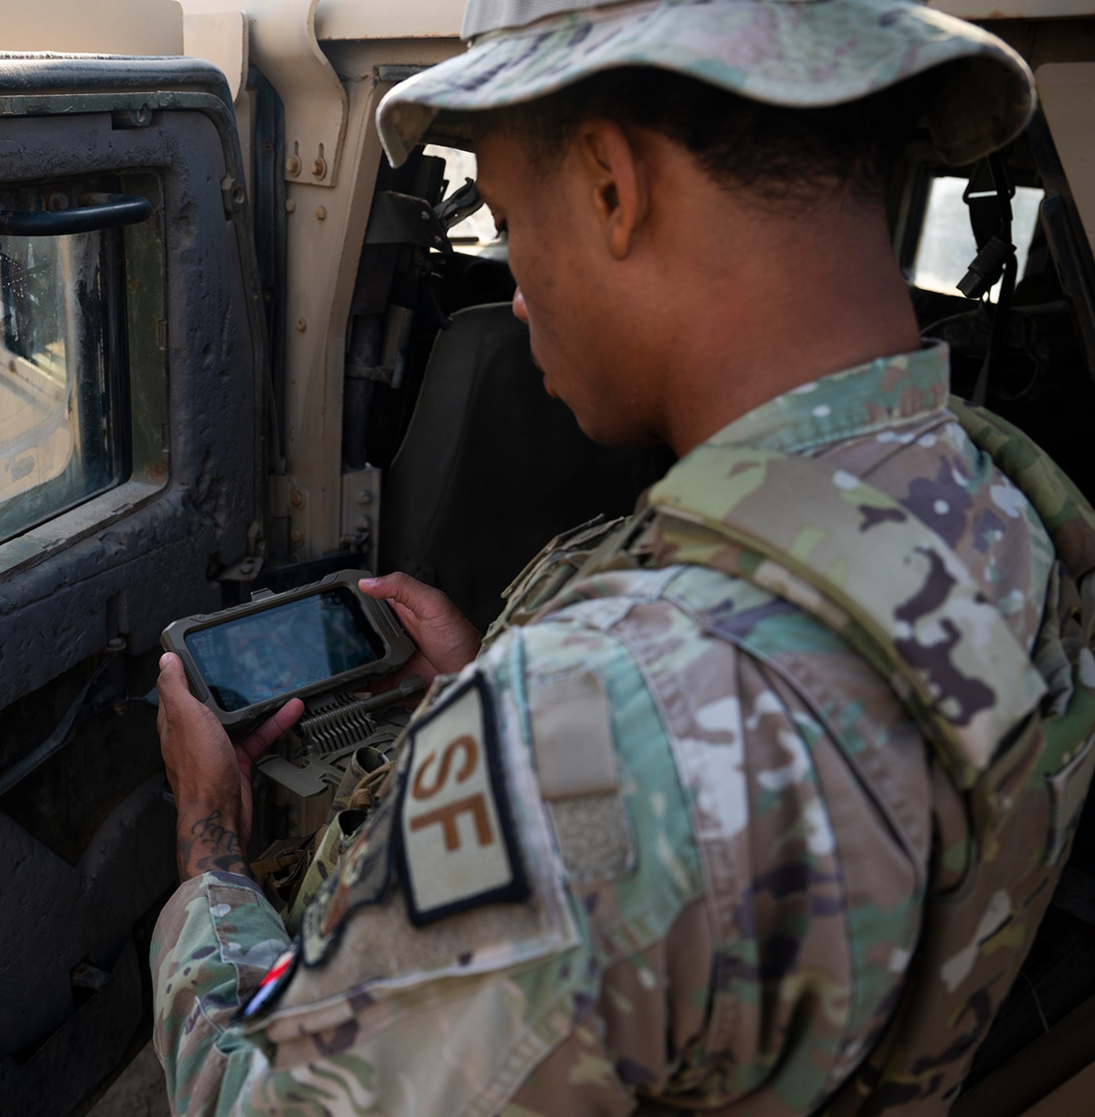
AFTAK Center of Excellence
Team Awareness Kit
Government Off the Shelf (GOTS) situational awareness application
Communications pathway agnostic
Real-time tactical edge common operating picture
  From ops centers to dismounted ops
WHAT IS TAK
Core Capabilities
Live Blue Force Tracking
Mapping positions, obstacles, and critical infrastructure
Sensor feeds integration
Data sharing: text, images, mission overlays, targets
Rapid Joint & Combined communications tool
Route planning, site surveys, & mission execution
Extensible plugin architecture: mission specific capabilities such as MEDEVAC, CBRN, & advanced sensing

Slide 6
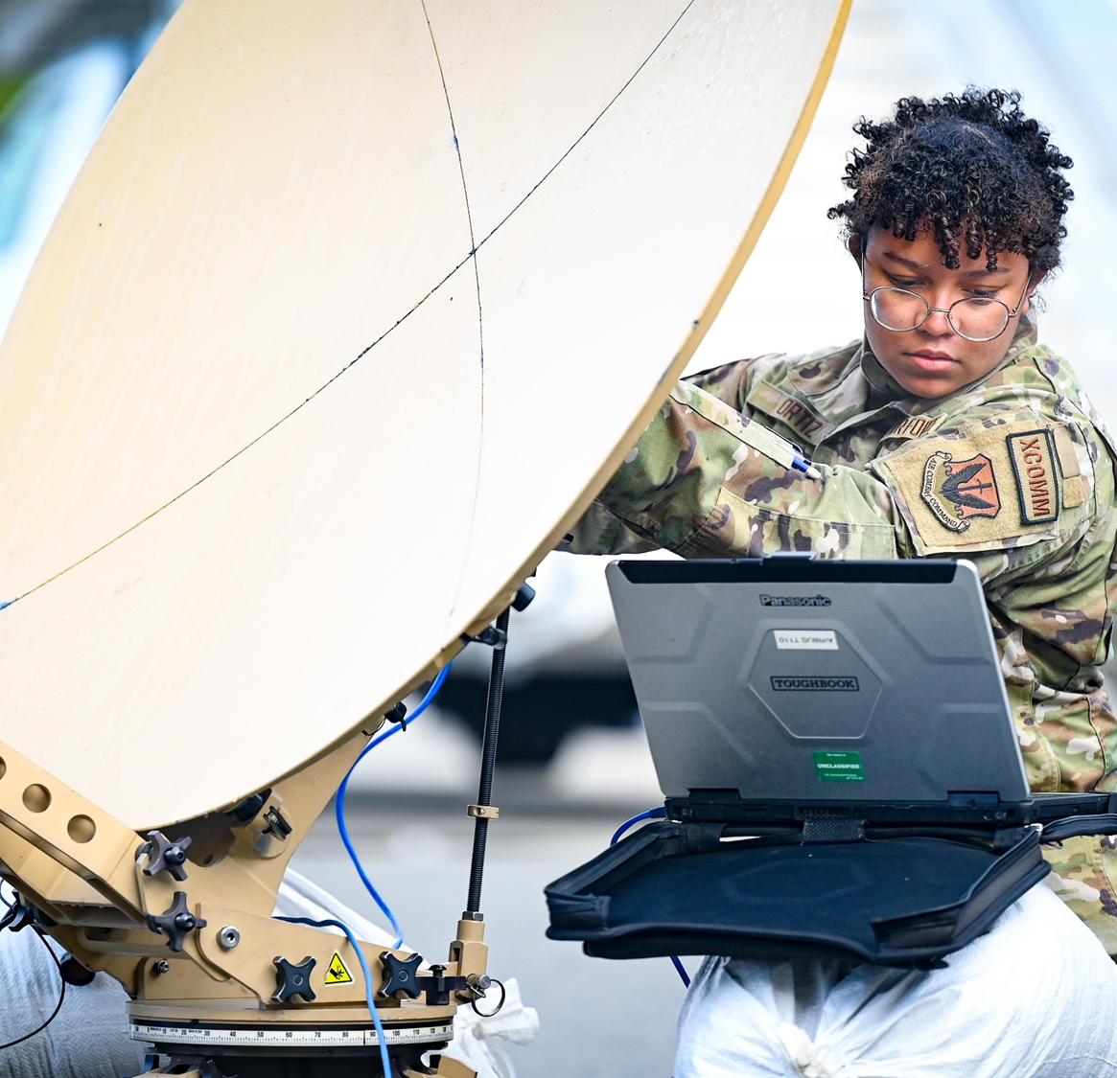
AFTAK Center of Excellence
Relevance for USAF
Precision Air-Ground operations
TAK is the standard for JTAC & TACP coordination & deconfliction
Integrated base defense & emergency response
Empowers emergency responders to manage incidents with shared, real-time data, aligning directly with programs like DMSAT
Agile Combat Employment (ACE)
Provides a low-footprint, decentralized C2 capability, enabling small, agile teams to operate effectively in austere environments
Joint & Coalition Interoperability
TAK is the de facto standard across the DoW and allied partners, ensuring operational synergy and communications during joint missions
230+ Approved & mature plugins to date and counting!
Satellite imagery
UXS control & telemetry
Medical triage
Camera control
Crowd sourced, infinitely scalable, zero licensing.
WHY TAK

Slide 7


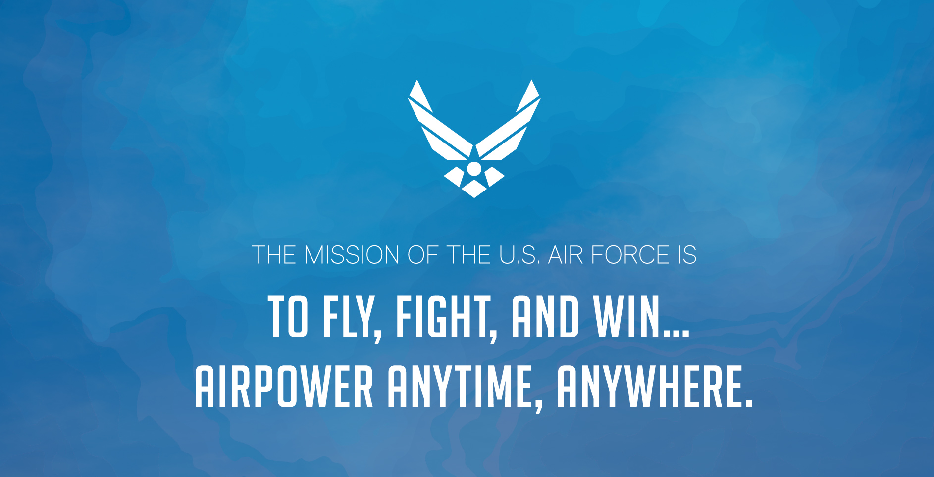
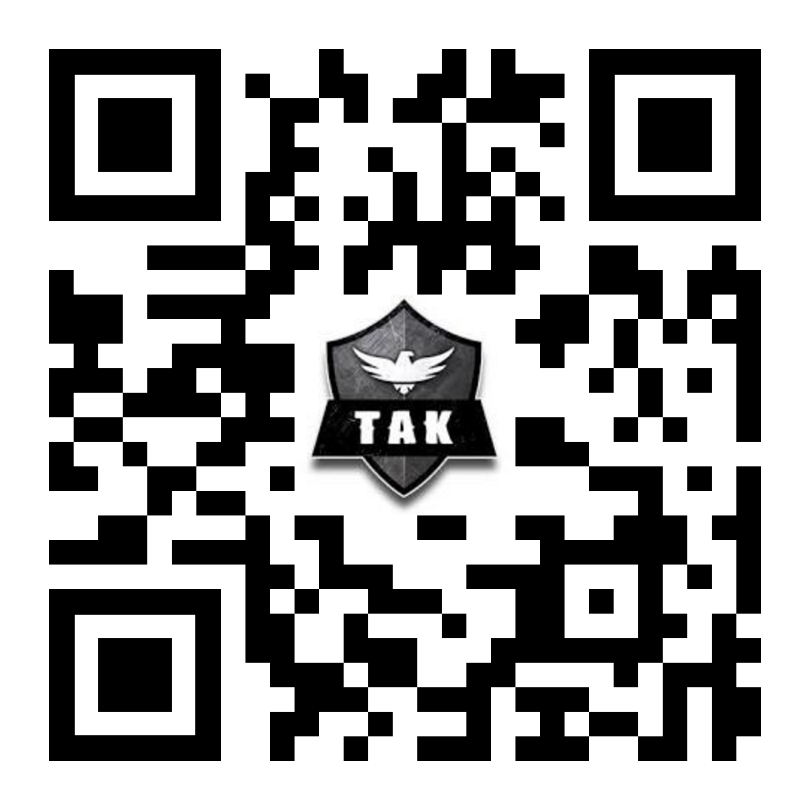
AFTAK Center of Excellence
CoE page (CAC cert required)
https://usaf.dps.mil/sites/22684/WPAFB/WPAFB_C2_Modernization/TAK%20Center%20Of%20Excellence
TAK promo video (No CAC required)
https://vimeo.com/1029268236/8edba1e0fb?share=copy
For inquiries:
  Kevan.dilworth.3@us.af.mil
  937.713.3938 (comm)
  937.564.3044 (cell)
FAQ page (No CAC required)
https://faq.aftakcoe.org/

Slide 8
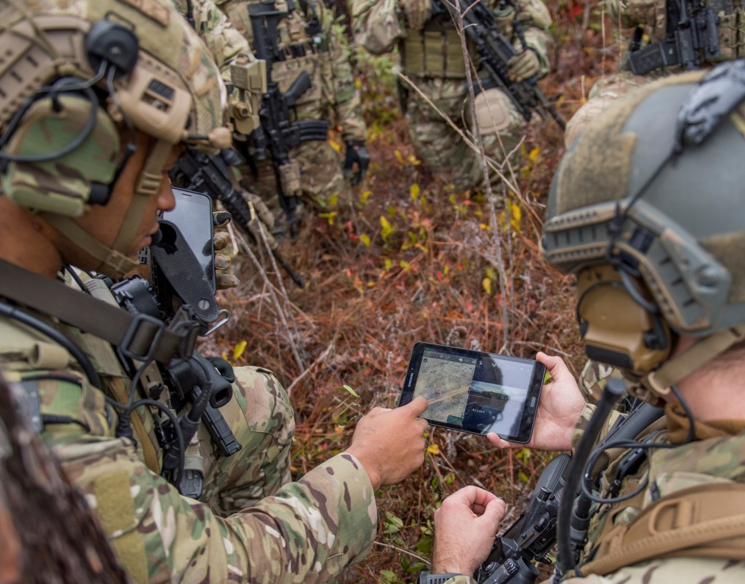
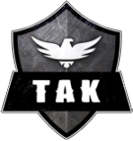
Thank You!

